Slide 1
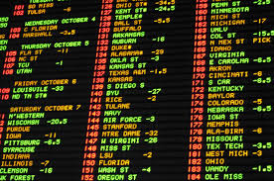
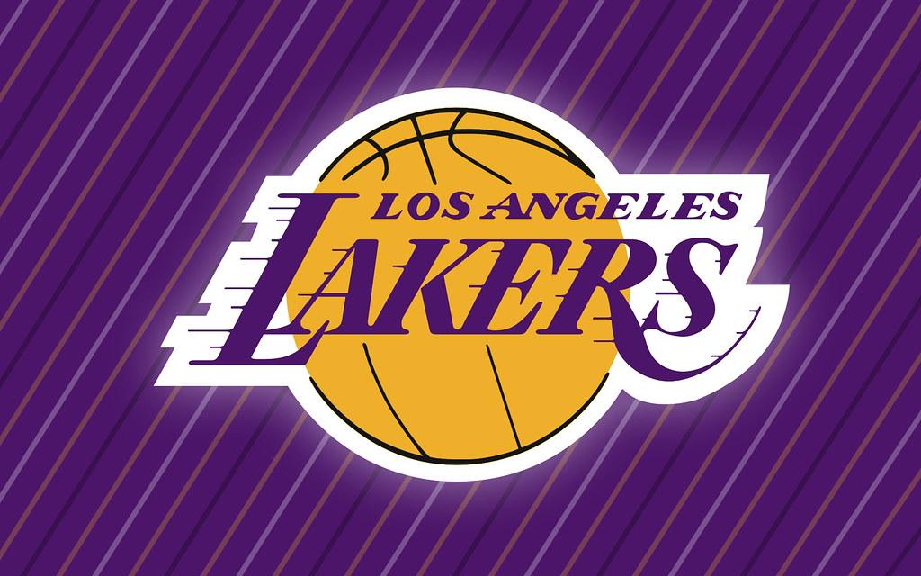
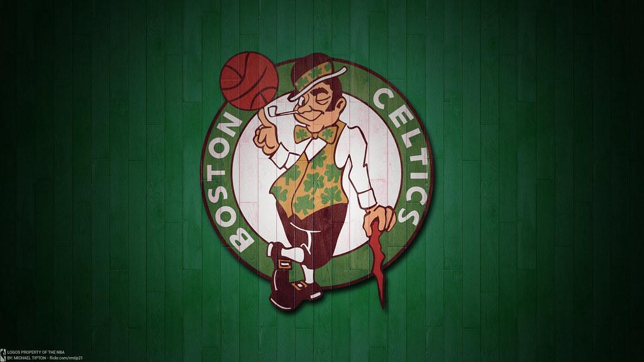
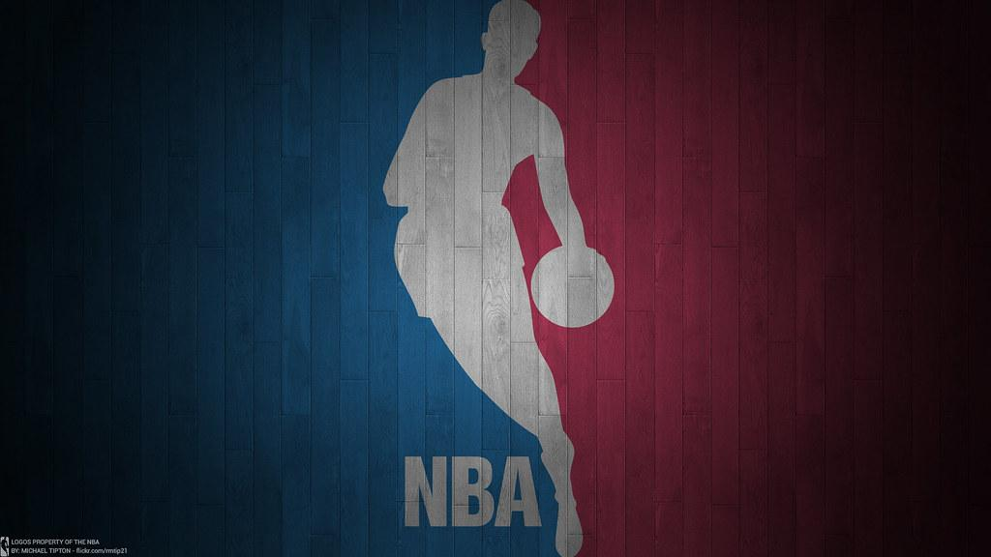
NBA Predictive Model
By Matt Pucci
Notes:
Did you know that in the next few years the sports betting market will be over 8 billion dollars? With the emerging partnerships with global casinos, it is only a matter of time before this number grows even higher. As the old adage goes, “Vegas always wins”. What if I told you that I could show you how to win 80% of the time on NBA Moneyline picks? Why should you believe me? Let me tell you a little about myself and my motives behind creating this model.
One of my passions in life is sports. I love playing them and I especially love watching them. If I could have any job in the world it would be the President or Head of Analytics of a professional franchise. With today's emerging sportsbook market, I wanted to focus my project on a model that could be used by both fans and sports bettors to put some data driven insight behind their moneyline picks. In sportsbetting Moneyline simply means win or lose, there is no point spread involved. The dataset was taken from Kaggle and the methodology used in this project was the traditional OSEMIN.

Slide 2
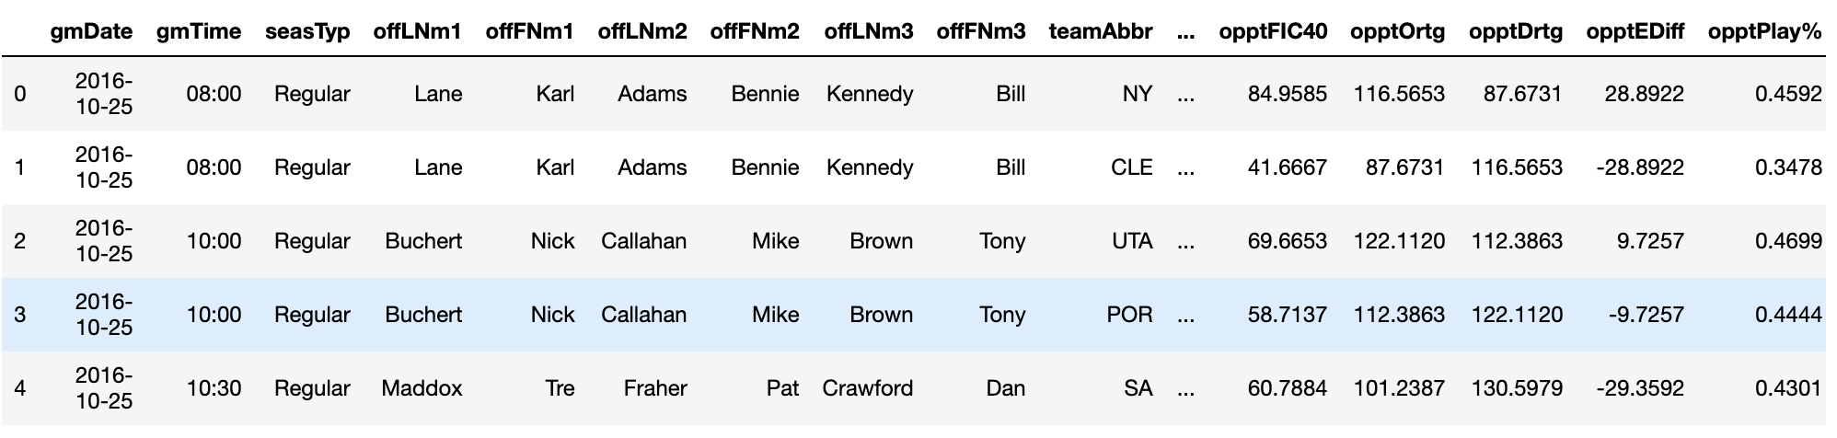
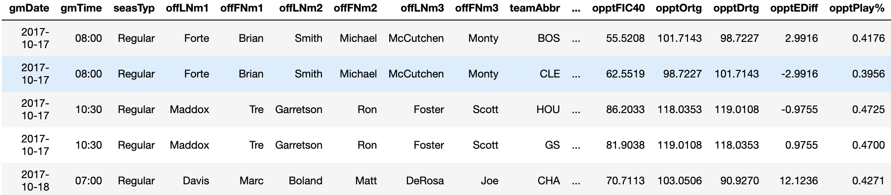
Data and Methodology
Train Data Head:
Test Data Head:
Notes:
The data for this project was taken from Kaggle with the train data being the official Team Box Scores from 2012-2016 and the test data being the official team box scores from 2017-2018. The data sets contained over 130 different variables and required quite a bit of preprocessing. The methodology used in this project was the traditional OSEMIN. Most of the preprocessing was done by transforming categorcal variables into numerics.

Slide 3
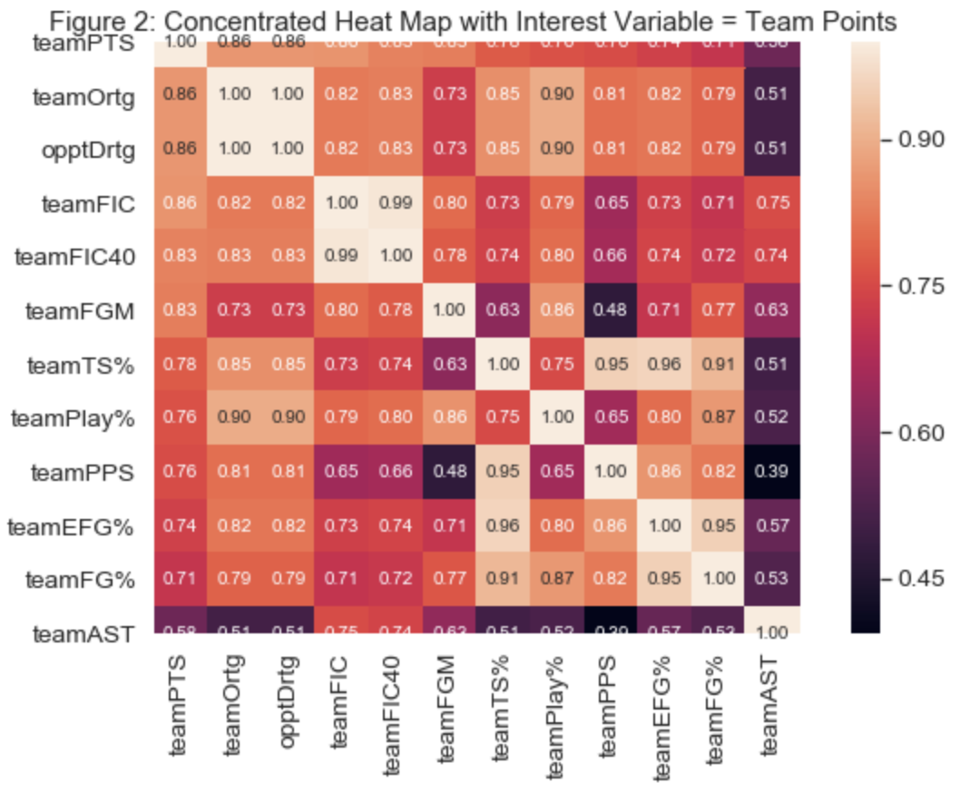
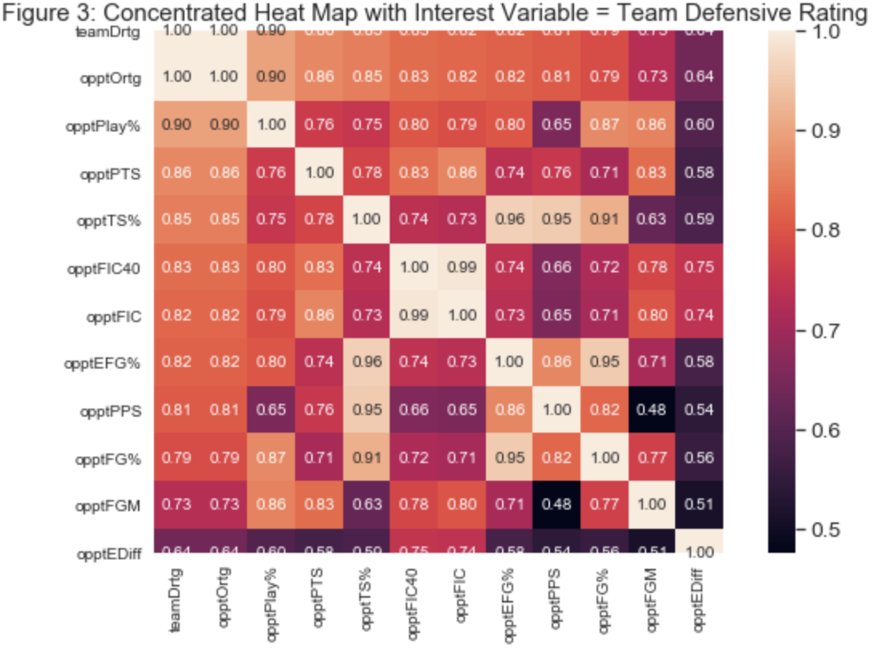
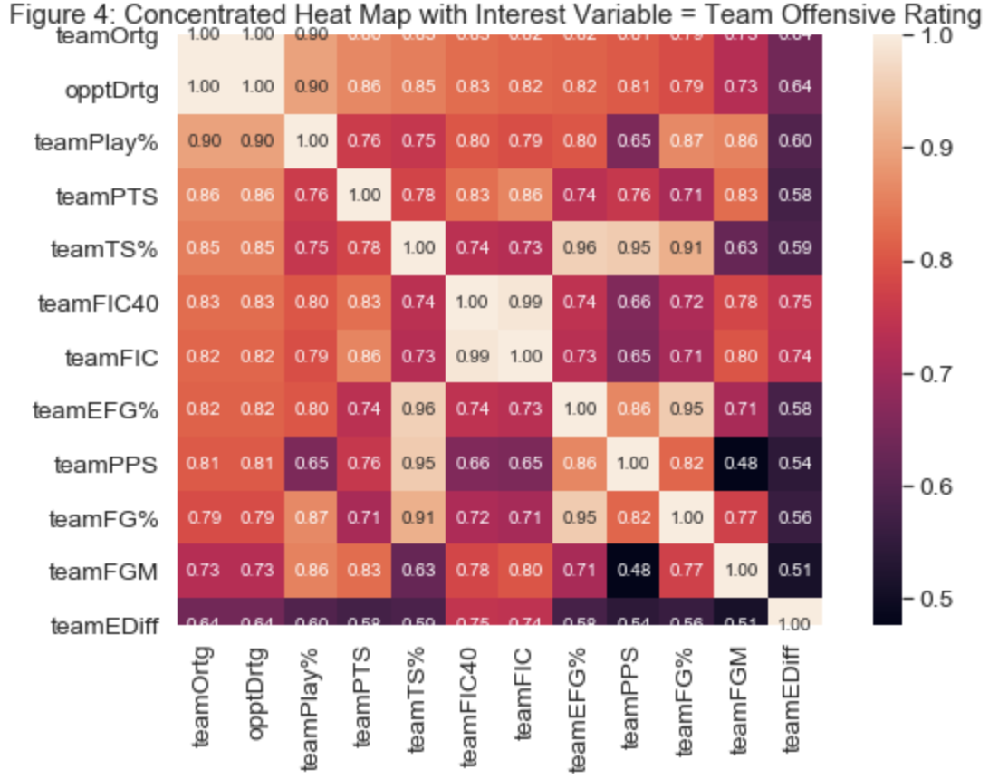
Data Exploration: Seaborn HeatMaps
Notes:
A total dataset Seaborn Correlation heat-map has too many variables to make any sense of it. To work around this I created heatmaps with three different interest variables, Team Points, Team Defensive Rating and Team offensive Rating. In the visuals you can see some highly correlated features, to get an easy to understand visualization I leveraged LightGBM to create a bar graph of NBA feature importance that was crucial to my model tuning.

Slide 4
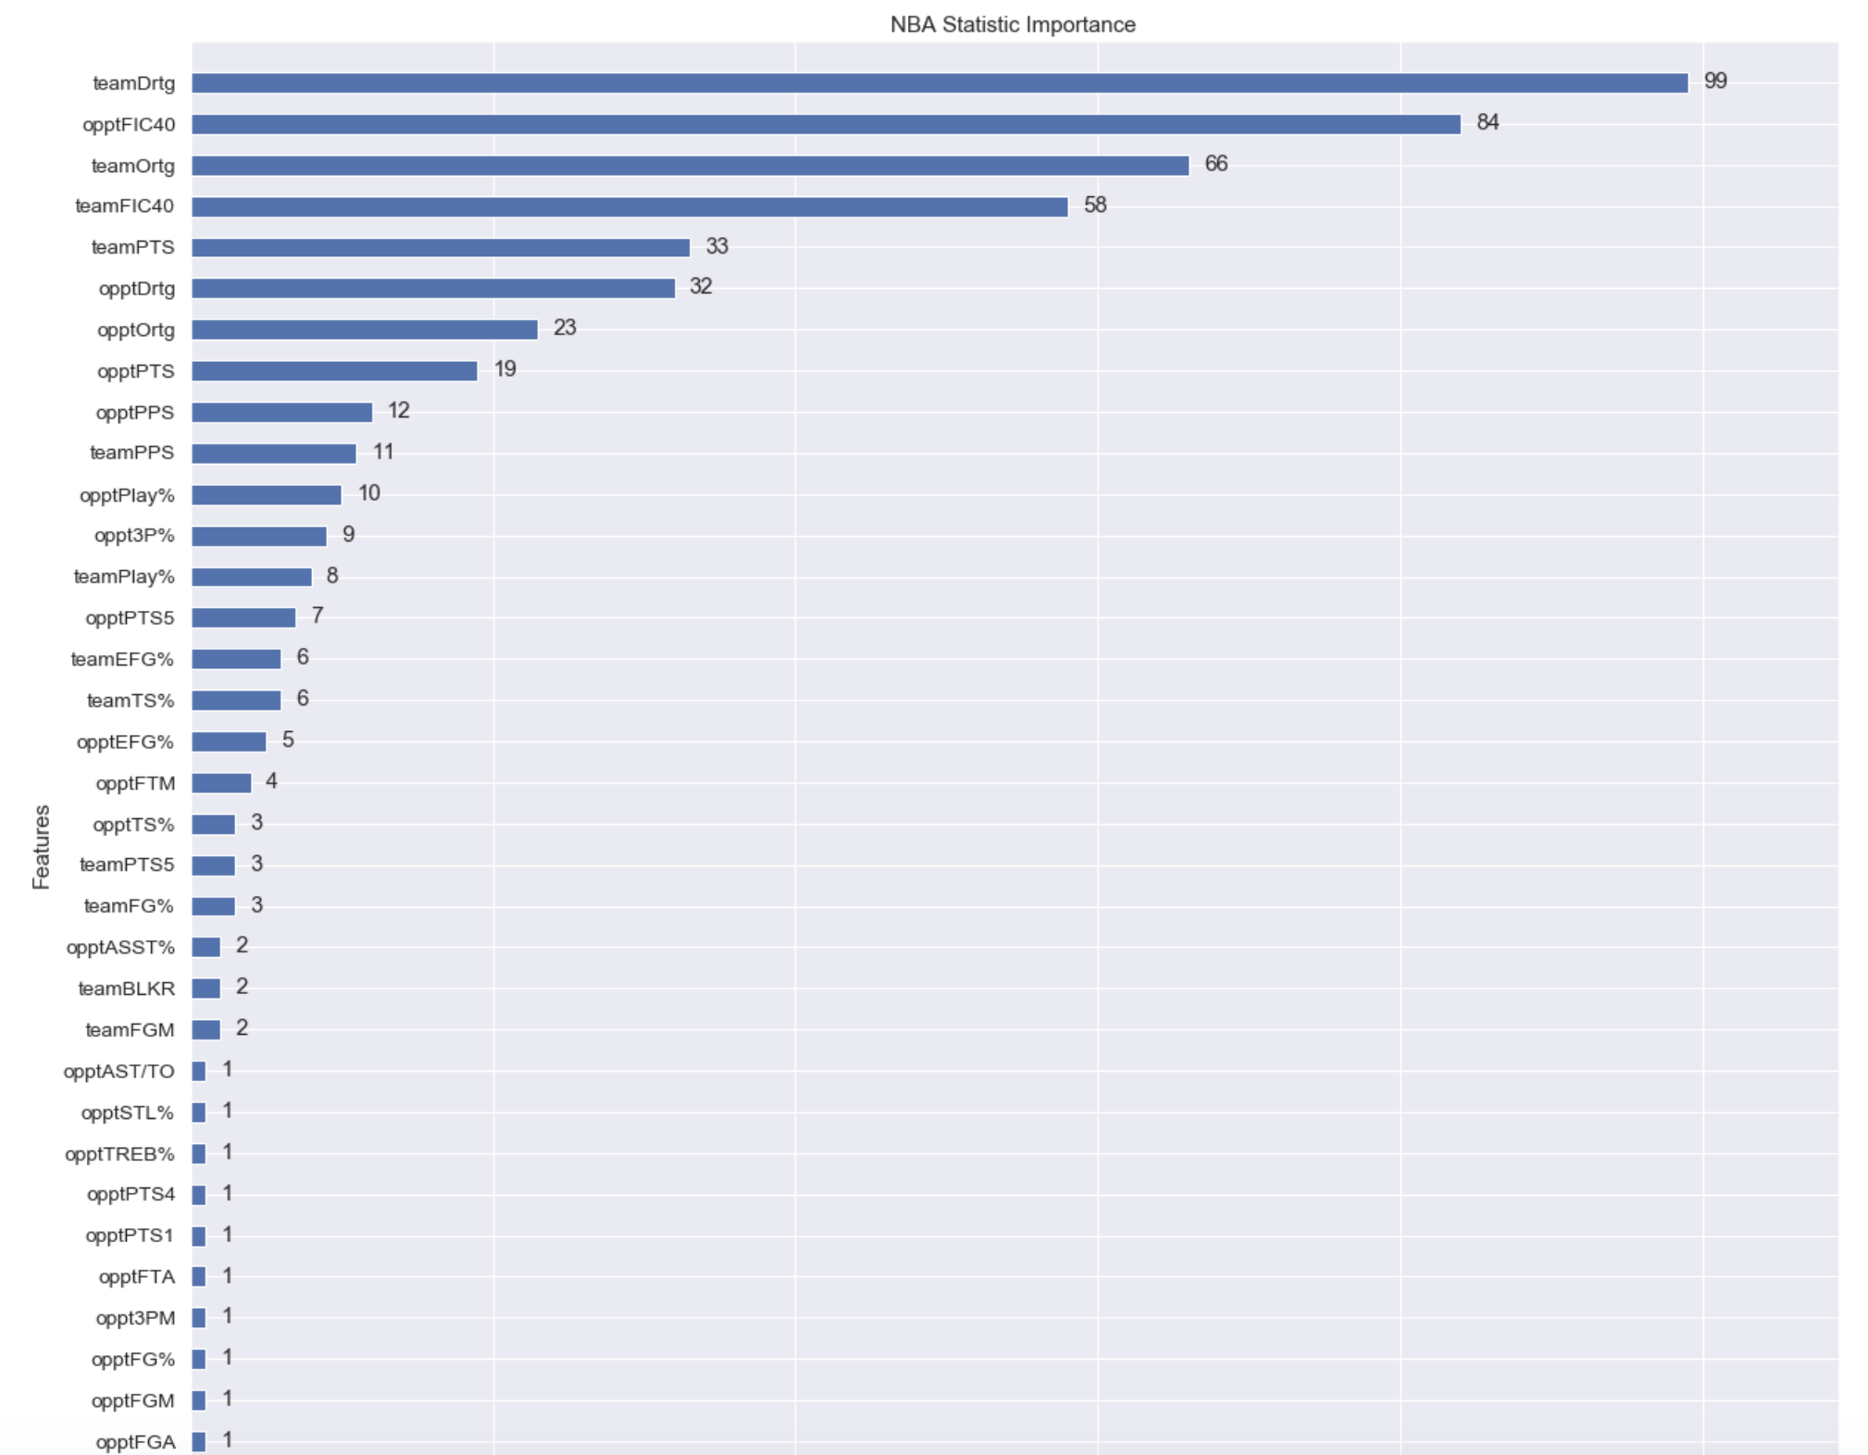
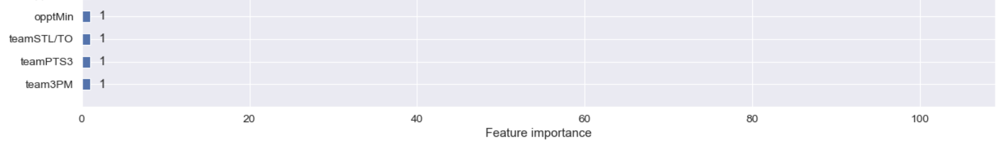
Notes:
This visualization gives us a lot of helpful insights on what features matter the most when the interest variable is Team Result. However, as I tuned the models it became clear that a lot of these statistics would lead to an unrealistic version of the model performing with far too high of accuracy. The respective classification models performed as follows

Slide 5
Model Performance
Model | Performance
KNN | 0.8130081300813008
Random Forest Classifier | 0.8211382113821138
Gradient Boost Classifier | 0.8257113821138211
Notes:
The Gradient Boost Classifier performed best and even more so after conduting a GridSearchCV with Gradient boost with over 800000 total fits. The code took about 30 minutes to run but gave the optimal parameter tunings for the mode. With the optimal tuning I then applied the gradient boost classifier to the predictive model. The model in its current states requires users to manually type the Team Abbreviations to see the prediction so for sake of time I tested the first 10 games of the season.

Slide 6
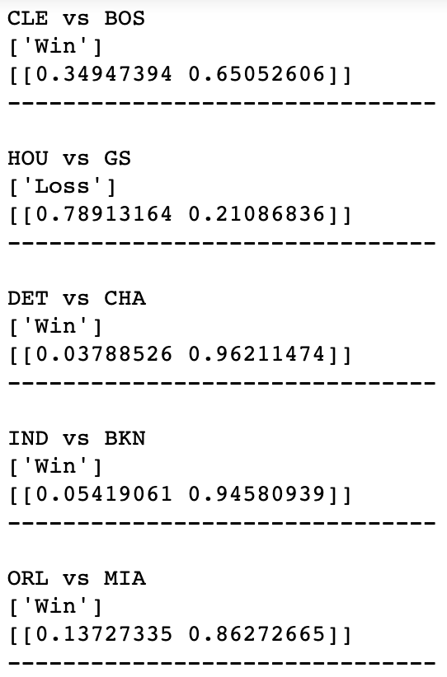
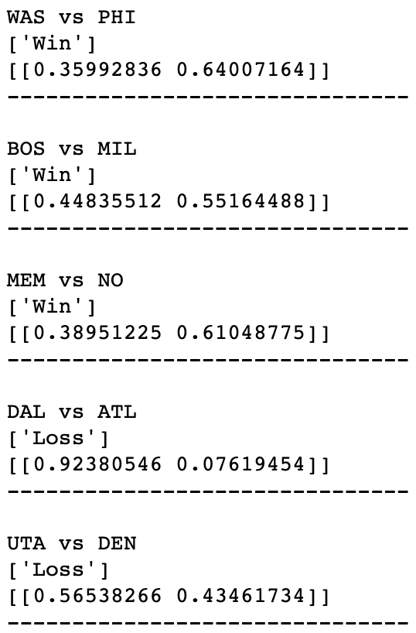
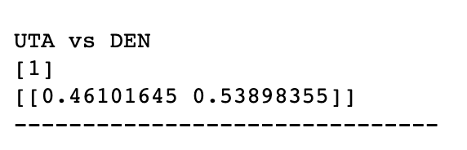
Model Results
Notes:
Some interesting initial results. Here are the actual scores and whether or not the model predicted correctly.
CLE 102 BOS 99 - CORRECT
HOU 122 GS 121 - INCORRECT
DET 102 CHA 90 - CORRECT
IND 140 BKN 131 - CORRECT
ORL 116 MIA 109 - CORRECT
WAS 120 PHI 115 - CORRECT
BOS 100 MIL 108 - INCORRECT
MEM 103 NO 91 - CORRECT
DAL 111 ATL 117 - INCORRECT
UTA 106 DEN 96 - CORRECT
For the first 10 games of the season, the model predicts 6/10 correctly, with some games incredibly close showing some opportunity areas with this model. Some key points from these games:
The Houston vs Golden State game was decided by a single point scored in the last minute as well as a GS buzzer-beater that was ruled no-basket after the game had ended.
The incorrect pick on BOS vs MIL came on a back to back night for Boston. The Celtics played a strong Cleveland team the night before and Gordon Hayward suffered a season ending gruesome injury. Perhaps this played a role in this game that the model could not capture.
The DAL vs ATL incorrect picks show expected model errors.

Slide 7
Future Work
Clearly this model is still in its early stages and it does not capture all of the factors that go into winning a NBA game.
Some features I would like to improve on:
Importance of game - rivalry, personal inspiration for players.
Injuries - As mentioned the model fails to be able to capture any injuries that would severely affect a team.
Referees - It is well known that some players have issues with certain referees. I would like to be able to quantify this and apply it to the model.
Spread Calculator - Although this model is in a good starting position, I would like to add a feature that predicts the point spread so it can truly be used as a Sports Bettor tool.

